Slide 1
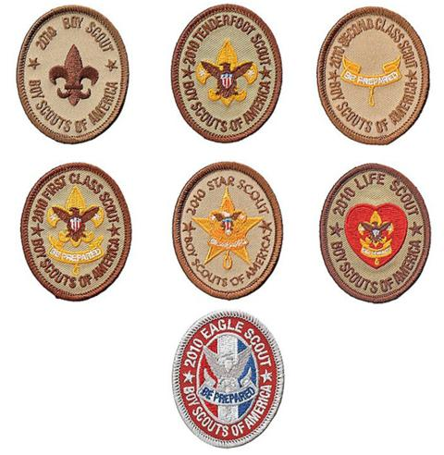
Introduction to Leadership Skills for Troops
Troop 125

Slide 2
The Scoutmaster’s Role
“Training boy leaders to run their troop is the Scoutmaster's most important job.”
“Train Scouts to do a job, then let them do it.”
“Never do anything a boy can do.”
—Robert S. S. Baden-Powell

Slide 3
Today’s Agenda
Module One—Troop Organization includes a description of each leadership position in the troop, including roles and responsibilities, troop organization, and introductions to vision and servant leadership. (About an hour…)
Module Two—Tools of the Trade covers some core skill sets to help the Scout lead, including communicating, planning, and teaching. (About an hour and a half…)
Module Three—Leadership and Teamwork incorporates additional leadership tools for the Scout, including discussions of teams and team characteristics, the stages of team development and leadership, inclusion/using your team, ethics and values of a leader, and a more in-depth review of vision. (About an hour…)

Slide 4
Introduction to the Course
The purpose of this course
Where ILST fits into Scouting’s Youth Training Continuum
ILST to NYLT to NAYLE
Course logistics
Food
Restrooms
Breaks
Phone calls and cell phone/texting etiquette
ILST
NYLT (Big Horn)
NAYLE
Enables
Enables
KODIAK
Notes:
-Provide the foundational unit-level leadership skills every scout leader should know
-Provide a clearer picture of how the position fits into the troop and how he can make a difference
-Provide tolls and ideas for fulfilling his role
Being a leader is not about “themselves”
Leading to make a difference = help those they lead be successful in their roles

Slide 5
Introduction to this Course
Leadership in Boy Scouting
Leadership is a vital part of the Scouting program.
Opportunities to develop leadership skills are a key part of Scouting – every bit as important as rank!
Key activities of youth leaders…
Organizing the troop
Planning and organizing activities and meetings
Assigning duties to others
Planning menus and figuring out food costs
Encouraging advancement
Guiding a troop’s involvement in problem-solving
Teaching outdoor, sports, or craft skills
Ensuring the troop’s safety during meetings and outings
Handling the troop’s finances
Helping other Boy Scouts make the most of their own leadership opportunities
Encouraging participation

Slide 6
Youth Training Continuum
Taught at the Regional/National Level
Taught at the Unit Level
Taught at the Council Level
ILST
NYLT (Big Horn)
NAYLE
Enables
Enables
Enables
KODIAK
Kodiak is an adventure – to push your boundaries and apply your leadership skills
Notes:
ILST – Intro to Leadership Training
NYLE- National Youth Leadership Training
NAYLE – National Advanced Youth Leadership Experience
Be-Know-Do
“Be” encompasses many of the values of Scouting.
“Know” describes the information that the Scout needs to successfully fill his leadership position
“Do” provides the youths with a vast set of skills to be effective in his position

Slide 7
Module One – Unit Organization
Module Overview
Introduction to the Course - 5 minutes
Introduction to Vision - 5 to 10 minutes
Troop Organization - 20 to 35 minutes
The Team-Based Troop - 25 to 30 minutes
Introduction to Servant Leadership - 5 to 10 minutes

Slide 8
Introduction to Vision
Critical to success in any role or project
Developed and shared by all members
Share and discuss the vision of the Senior Patrol Leader (SPL) and Scoutmaster
Notes:
Vision critical to success
What does success look like ?
In Scouting, a troop’s vision is something developed and shared by all members. It identifies where the troop is going—what it wants to accomplish

Slide 9
Troop Organization
Committee
Scoutmaster
Assistant Scoutmaster –
New Scout Patrol
Junior
Assistant Scoutmaster
Assistant Scoutmaster(s)
Assistant Scoutmaster – Venture Patrol
Assistant
Senior Patrol Leader(s)
Senior
Patrol Leader
Patrol Leaders'
Council
Troop
Guide(s)
New Scout
Patrol Leader
Venture Patrol Leader
Patrol Leader
Patrol Leader
Patrol Leader
Assistant
Patrol Leader
Assistant
Patrol Leader
Assistant
Patrol Leader
Den Chief
Patrol
Scribe
Quartermaster
Grubmaster
Cheermaster
Patrol
Scribe
Quartermaster
Grubmaster
Cheermaster
Patrol
Scribe
Quartermaster
Grubmaster
Cheermaster
Webmaster
Bugler
OA Troop
Representative
Instructor
Quartermaster
Scribe
Librarian
Historian
Chaplain Aide
Notes:
Note youth alignment to adult positions
Note the youth positions have responsibilities to one another
Youth positions are both elected and appointed

Slide 10
Troop 125 Organization
Scoutmaster
Mr. Kowalski
ASM
New Scout Patrol
TBD
ASM
Mr. Zambito
ASM
Training
Mr. Weinberg
ASM
Outdoor Coord.
Mr. Isaac
ASM
Mr. Bromberg
ASM
Quartermaster
Mr. Ryan
ASM
High Adventure
Mr. Ellenbogen
ASM
Mr. Condell
ASM
Administrator
Mr. Van Loon
ASM
Venture Patrol
TBD
Patrol Leaders’ Council
SPL
Josh I.
ASPL
Paul M.
ASPL
Ryan M.
Troop
Guide(s)
New Scout
PL – TBD
Flying Squirrels
PL – Dominic P.
Robot
PL – Frank M.
Cobra
PL – Anthony C.
Coyote
PL – Ken D.
Dragons
PL – Jared I.
Venture Patrol
PL – TBD
Webmaster
Bugler
APL
APL
APL
APL
APL
Den Chief
OA Rep
Instructor
Quartermaster
Scribe
Librarian
Historian
Chaplain Aide

Slide 11
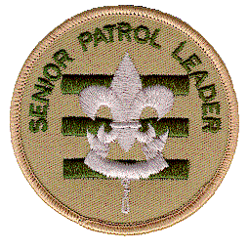
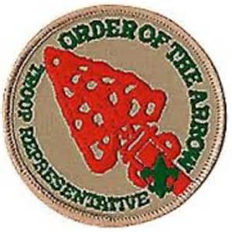



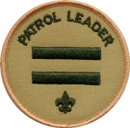

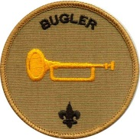
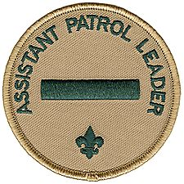
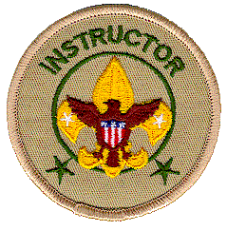


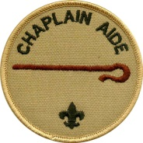
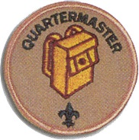

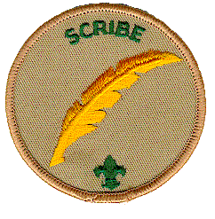
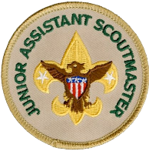
Scout Positions
Senior Patrol Leader
Order of the Arrow Rep
Assistant Sr. Patrol Leader
Historian
Webmaster
Patrol Leader
Librarian
Bugler
Assistant Patrol Leader
Instructor
LNT Trainer
Troop Guide
Chaplain Aide
Quartermaster
Den Chief
Scribe
Jr. Assistant Scoutmaster

Slide 12
All Leaders
Set and enforce the tone for good Scout behavior within the troop
Set a good example
Wear the Scout uniform correctly
Live by the Scout Oath and Scout Law
Show and help develop Scout spirit

Slide 13
Senior Patrol Leader
Presides at and runs all troop meetings, events, activities, and annual program planning conference
Runs the Patrol Leaders’ Council meeting
Appoints other junior troop leaders with the advice and counsel of the Scoutmaster
Assigns duties and responsibilities to junior leaders
Assists the Scoutmaster with Junior Leader Training

Slide 14
Assistant Senior Patrol Leader
Helps the Senior Patrol Leader lead meetings and activities
Runs the troop in the absence of the Senior Patrol Leader
Helps train and supervise the troop scribe, quartermaster, Order of the Arrow representative, instructor, librarian, historian and chaplain aide
Serves as a member of the Patrol Leaders’ Council

Slide 15
Patrol Leader
Appoints the Assistant Patrol Leader
Represents the patrol on the Patrol Leaders’ Council
Plans and steers patrol meetings
Helps Scouts advance
Acts as chief recruiter of new Scouts
Keeps patrol members informed
Knows what his patrol members and other leaders can do

Slide 16
Assistant Patrol Leader
Helps the patrol leader plan and steer patrol meetings and activities
Helps the patrol leader keep patrol members informed
Helps the patrol get ready for all troop activities
Represents his patrol at Patrol Leaders’ Council meetings in the patrol leader’s absence
Lends a hand controlling the patrol and building patrol spirit
Leads the patrol in the patrol leader’s absence

Slide 17
Troop Guide
Guides new Scouts through early Scouting activities
Shields new Scouts from harassment by older Scouts
Helps new Scouts earn First Class in their first year
Guide new Scouts through early troop experiences to help them become comfortable in the troop and in the outdoors (going with them on outings)
Teaches basic Scout skills
Coaches the patrol leader of the new Scout patrol in his duties
Attends Patrol Leaders’ Council meetings with the patrol leader of the new Scout patrol
Helps set and enforce the tone for good Scout behavior within the troop

Slide 18
Quartermaster
Keeps records on patrol and troop equipment
Makes sure equipment is in good working condition
Issues equipment and makes sure it is returned in good condition
Makes suggestions for new or replacement items for equipment
Gets the U.S., troop and patrol flags for meetings and ceremonies and puts them away afterwards

Slide 19
Scribe
Attends and keeps a log of Patrol Leaders’ Council meetings
Records attendance and dues payments of all troop members
Records advancement in troop records and on the troop advancement chart
Works with the appropriate troop committee members responsible for finance, records, and advancement
Handles correspondence appropriately

Slide 20
Order of the Arrow Representative
Encourages older Scout participation in high adventure programs
Encourages year-round and resident camping in the troop
Encourages Arrowmen to assure leadership positions in the troop, participate in lodge and/or chapter activities and seal their OA membership by becoming Brotherhood members

Slide 21
Historian
Gathers pictures and facts about past troop activities and keeps them in a historical file or scrapbook, wall displays, etc.
Takes care of troop trophies, ribbons and souvenirs of troop activities
Keeps information about former members of the troop (alumni)
Keeps the troop display cabinet updated and in order
Maintains troop photo CDs, music CDs and DVDs

Slide 22
Librarian
Establishes and maintains a troop library
Keeps records of books and pamphlets owned by the troop
Adds new or replacement items as needed
Makes literature available for borrowing
Maintains a system to check literature in and out
Follows up on late returns
Notes:
Keep up to date on latest changes to mb program

Slide 23
Instructor
Teaches basic Scouting skills within the troop and patrols
Prepares well in advance for each teaching assignment
Proficient in both Scouting skills and the ability to teach those skills to others
Sets a good example

Slide 24
Chaplain Aide
Assist the troop chaplain with religious services at troop activities
Tells Scouts about the religious emblem program for their faith and gives an overview of the various religious emblems programs to the troop annually
Makes sure religious holidays are considered during troop program planning
Helps plan for religious observance in troop activities
Serves as youth coordinator for the observance of the annual Scout Sunday and Scout Sabbath
Composes and leads a Scout’s Own service appropriate for all troop members during weekend campouts and prepares a troop prayer

Slide 25
Den Chief
Serves as the activities assistant at den meetings
Meets regularly with the den leader to review the den and pack meeting plans
Encourages Cub Scout advancement
If serving as a Webelos den chief, helps prepare boys to join Boy Scouting
Project a positive image of the troop and Boy Scouting

Slide 26
Junior Assistant Scoutmaster
Functions as an Assistant Scoutmaster, except for those leadership responsibilities reserved for adults 18 and older
Accomplishes any duties assigned by the Scoutmaster
Sets a good example

Slide 27

Webmaster
Establishes and maintains a safe and secure troop website
Ensures the troop website is a positive reflection of Scouting for the public
Manages the troop’s electronic communication tools
Works with the Scouts to provide up-to-date troop information
Works with the scribe
Notes:
Facebook

Slide 28
Leave No Trace Trainer
Has a thorough understanding of and commitment to Leave No Trace
Successfully completed the Leave No Trace Trainer training course
Helps minimize the troop’s impact on the land by teaching Scouts the principles of Leave No Trace
Helps ensure that the troop follows Leave No Trace principles on all outings

Slide 29
Bugler
Plays the bugle to mark key moments during the day and evening on troop outings and events, such as reveille and lights out
Knows the required bugle calls
Has, or is working towards getting, the Bugling merit badge

Slide 30
Adult Troop Positions
Adults in the troop are responsible for providing training to troop leadership and enabling them to carry out their duties
They also provide resources for the troop leaders and serve as mentors to all Scouts in the troop
The number of adult leaders and committee members needed is dependent on the size and needs of the troop

Slide 31
Scoutmaster
Trains and guides boy leaders
Works with other responsible adults to bring Scouting to boys
Uses the methods of Scouting to achieve the aims of Scouting
Meets regularly with the Patrol Leaders’ Council for training and coordination in planning troop activities
Attends all troop meetings or, when necessary, arrange for a qualified adult substitute
Attends troop committee meetings
Conducts Scoutmaster conferences for all rank advancement
Conducts periodic parents’ sessions to share the program and encourage parent participation and cooperation
Provides a systematic recruiting plan for new members and see that they are promptly registered
Delegates responsibility to other adults and groups (assistants, troop committee) so they have a real part in troop operations
Conducts all activities under qualified leadership, safe conditions, and the policies of the chartered organization and the Boy Scouts of America

Slide 32
Assistant Scoutmasters
To fulfill his or her obligation to the troop, the Scoutmaster, with the assistance of the troop committee, recruits Assistant Scoutmasters to help operate the troop.
Each Assistant Scoutmaster is assigned specific program duties and reports to the Scoutmaster.
They also provide the two-deep leadership required by the Boy Scouts of America (there must be at least two adults present at any Boy Scout activity).
An Assistant Scoutmaster may be 18 years old, but at least one in each troop should be 21 or older so he or she can serve in the Scoutmaster’s absence.

Slide 33
Committee Chair
Supervises the Scoutmaster and committee members
Recruits and approves Scoutmasters and committee members

Slide 34
Committee Member
Serves as a resource to the troop
Works with an assigned officer
Recruits consultants
Potential Roles:
Webmaster
Treasurer
Secretary
Merit Badge Coordinator
Quartermaster
Eagle Scout Coordinator
Camping Coordinator

Slide 35
Chartered Organization Representative
Serves as the liaison between the troop and the chartered organization
Recruits the troop committee; approves Scoutmasters and committee members
Participates in district leadership

Slide 36
Roles & Responsibilities - Breakout
Role Balancing – Balloon Toss
Reflection…

Slide 37
The Scout-Led Troop
Group Discussion: Leadership in Scouting
Discuss leadership in Scouting and the value of the Scout-led troop
Game: Yurt Circle
Reflection:
Key teaching points:
Notes:
Briefly discuss leadership in Scouting and the value of the Scout-led troop.
Empowering Scouts to be leaders is one of the core principles in Scouting.
Scouting is designed to help Scouts prepare to participate in, and give leadership to, American society.
A troop is
a small democracy. Within the safety framework provided by the adult leaders, and with the
Scoutmaster’s direction and mentoring, the Scouts plan and implement the troop program. Scouts
serve in positions of responsibility to make that happen.

Slide 38
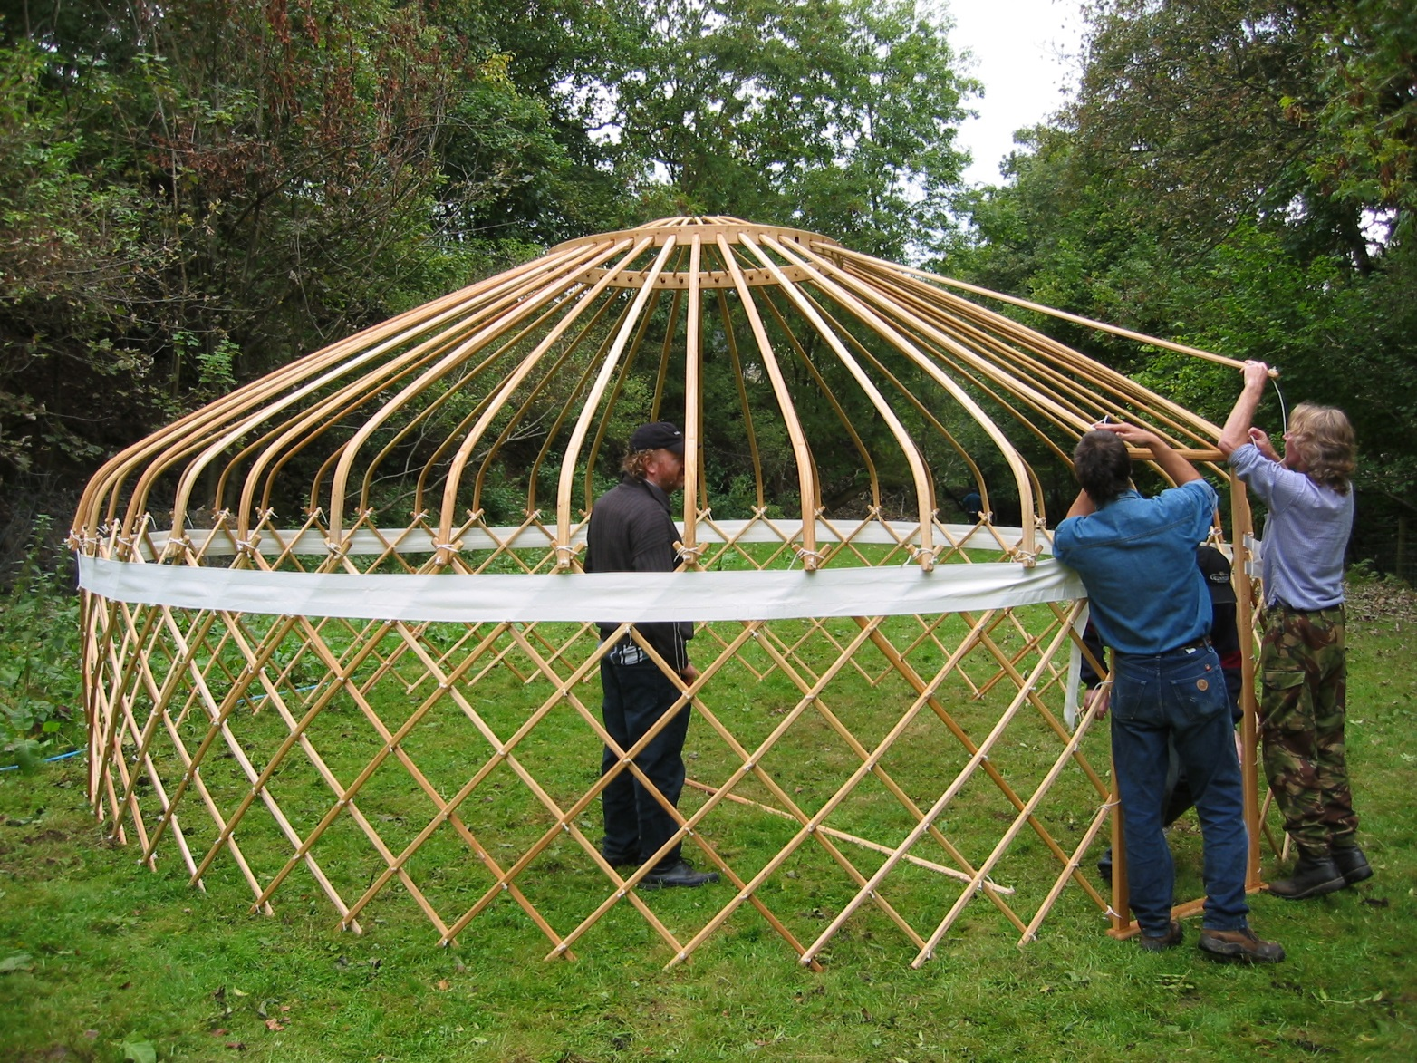
Yurt
Notes:
Sample questions:
•During the game, who led the group?
•Did someone step in as the leader, or did the group cooperate as equals?
•If someone stepped up, why did the group follow his lead?
•Did the size or age of the Scouts affect how the “leaning” worked?
•Why does the Scouting program have Scouts take on leadership roles in the troop?
•What do the Scouts lead in your troop?
•What do they not yet lead?

Slide 39
The Scout-Led Troop
Group Discussion: Patrol Leaders’ Council
Game: Helium Stick
Reflection:
Key points:

Slide 40
The Scout-Led Troop
Group Discussion: Define leadership
Group Discussion: Tips for Being a Good Leader in the Troop
Game: Willow in the Wind
Notes:
•Teamwork
•Using each other’s strengths
•Not trying to do it all yourself
•Doing what you said you’d do
•Being reliable
•Keeping each other informed
•Being responsible

Slide 41
Introduction to Servant Leadership
Group Discussion: Why Should Scouts Choose to Be Leaders?
Reflection:
Key points:
Notes:
-Choice to lead- to give rather then receive

Slide 42

Break!
Take 10 minutes…

Slide 43
Module Two– Tools of the Trade
Module Overview
Introduction to the Tools of the Trade Session – 5 mins
Communications – 20 to 30 minutes
Planning – 20 to 30 minutes
The Teaching EDGE – 15 to 25 minutes

Slide 44
Introduction to the Tools of the Trade
Communications – The skills of being an effective listener and an effective communicator are valuable tools for any leader.
Planning – Proper planning makes the difference in almost all Scouting activities.
Teaching EDGE – The Teaching EDGE method can be used any time a leader is helping others learn.

Slide 45
Communications
Basic Parts of ANY communication:
A sender → A message → A receiver
This is still a valid model today. It applies to all forms of communication: verbal, written, music, film, signaling, pantomime, teaching, etc.
Game: Receiving
Reflection:
Key points:
Notes:
• What’s the difference between hearing and listening?
• What is active listening?
• Is active listening a helpful/useful skill?
• Why do leaders need to be good listeners?
• What would have happened in the game if someone hadn’t passed the message on? What
happens in the troop when someone doesn’t pass the message on?
• In the game, did you check for cues that the listener understood your message? How?
• How would it have helped if you could have asked questions?
Some key teaching points:
• Listening is different than hearing—it involves actually receiving the message being sent.
• Focus on the person who is speaking and on what is being said. Stay engaged.
• Engage your brain when someone else is talking or communicating.
• Being a good listener is a very important part of being a good leader; you need to
understand what people are trying to say to you.
• Using active listening skills will help you as a leader.
• Pass the word—to your people or to the leadership team. Don’t break the
communications chain.

Slide 46
Key Listening Tips:
Listen with your eyes as well as with your ears. Watch for nonverbal cues.
Avoid distractions, both physical and mental. Give the speaker your full attention.
Try to see things from the speaker’s point of view. In other words, try to put yourself in the speaker’s shoes.
Apply the ideas to yourself. Think about how the speaker’s message relates to you and your experiences.
Ask questions if you are unclear about anything.
Review the speaker’s points and think what logically might come next in the message.
Curb your desire to talk until the speaker has finished.
Respond nonverbally (nod your head or smile) to the speaker.
Practice listening with respect for the speaker. Work hard not to interrupt even when you have a burning desire to make a point.

Slide 47
Effective Messages
Game: The Whole Picture
Reflection:

Slide 48
Effective Messages - Tips
Organize your thoughts
Minimize distractions
Get the audience’s attention first
Speak clearly and make eye contact
Repeat facts such as dates, times, and places.
Distribute notes

Slide 49
Planning
Second only to communicating, good planning is an essential skill for every effective leader.
At its core, planning is really just thinking ahead
Ask questions – develop answers
After initial planning (also called “happy path” planning), start asking “what if” questions
Adjust your plan to accommodate the unexpected
Next add the “who” – the resources to make it happen
Notes:
What do we want to do?
What is the desired outcome?
Where is a suitable site?
How will we get there?
What will we do once we get there?
What equipment do we need? Where do we get that equipment? Who is responsible for getting
the equipment? Who is participating? When is the activity?

Slide 50
Planning
Group Exercise: Planning
Plan as a group a sample troop service project
Scenario: On a Saturday, six weeks from now, the troop will conduct a service project at a local city park. The project involves:
Installing 50 feet of split-rail fence around a tree (to protect it)
Removing old plants and undergrowth from a nearby area (approximately 500 square feet in area). Laying down weed block in the cleared area. Spreading 6 cubic yards of mulch in the area just cleared and under the fenced-in tree
Planting 15 to 20 small plants and shrubs in a small garden in a third area nearby

Slide 51
Planning (exercise)
Task:
Plan what equipment you need for the project and how you’re going to get it. Plan how to use and manage your team on the day of the project.
Reflection – about the planning session
Reflection – about the project
Key points:

Slide 52
Teaching EDGE
The EDGE (Explain, Demonstrate, Guide, Enable) method is the primary training method to teach skills in the troop.
EDGE should be used for all teaching opportunities. Make it a habit.
It can be used anytime a leader is helping others learn.

Slide 53
The Four-Step EDGE Process
Explain -The trainer explains how something is done.
Demonstrate - After the trainer explains, the trainer demonstrates while explaining again. This gives the learner a clear understanding of what success looks like.
Guide - The learner tries the skill while the trainer guides him through it. The trainer gives instant feedback as the learner practices the skill.
Enable - The learner works independently under the watchful eye of the trainer. The trainer helps remove any obstacles to success, thus enabling the learner to succeed.
Sample skill instruction
Reflection:
Notes:
Some sample skills to teach:
• How to build/fold a paper airplane
• How to properly fold the U.S. flag (refer to page 31, of the BSA publication Your Flag)
• How to tie a knot
• How to perform a basic first-aid activity
• How to toss a small object into a coffee can from a short distance
• How to properly lace up a hiking boot (or tie a shoe)

Slide 54
Tools of the Trade (Wrap-up)
Communications, planning, and teaching —are core skills leaders can use any time they are working with their team
Good planning is foundational to everything
As you grow in Scouting and take on more leadership roles, your leadership skills and strengths will continue to grow over time.

Slide 55

Break!
Take 15 minutes…

Slide 56
Module Three – Leadership & Teamwork
Module Overview
Introduction to Leadership and Teamwork Session - 5 minutes
Teams and Team Characteristics - 5 to 10 minutes
Stages of Team Development and Styles of Leadership - 15 to 25 minutes
Inclusion - 10 to 15 minutes
Leadership Ethics and Values - 15 to 25 minutes
Vision - 5 minutes
Wrap Up the Introduction to Leadership Skills for Troops Course - 5 minutes

Slide 57
Introduction to Leadership and Teamwork Session
Discussion: What do we mean by “team”?
Characteristics of effective teams? (list on a board)
Notes:
Setup Required - Game: Integrity Game—Part 1, Setting the Stage. Sometime during the first 15 to 20 minutes of
Module Three, put out a tray of cookies or small wrapped candies for the Scouts. Before putting
out the tray—and without the Scouts seeing you—count the number of Scouts in attendance.
Then count out enough cookies or candies so each Scout can get two pieces, plus have a few
more (one to four) pieces left over on the tray. The Scouts should not be aware of this counting
and preparing. Simply put the tray out and tell the Scouts that they may take two pieces any time
during the session as a reward for their participation in the class.

Slide 58
Stages of Team Development
Discussion: How do teams develop?
Review team development through a discussion
Notes:
Teams go through various stages of development as they come together. Individual people go through the same stages—and their natural ups and downs—as they take on new tasks or roles.
To get a better sense for how this might work in a team, let’s first look at how it works in us as individuals.

Slide 59
Where the Group Is
Stages:
Starting out (skills are low, enthusiasm is high)
Becoming discouraged (skills and enthusiasm are low)
Making progress (skills and enthusiasm is rising)
Finding success (skills and enthusiasm are high)
Team Skill Level and Enthusiasm
Skill Level – rises over time
Enthusiasm – varies as the team develops
Discussion: How can the leader affect the team’s development?
Notes:
Team Skill Level and Enthusiasm
• Skill Level—Generally, the skill level of the team starts low and increases as the team
grows together and gets better at working as a team.
• Enthusiasm—Often, unlike skill level, enthusiasm usually starts out high but can then
take a sudden dip. Then, as the team members explore their differences and align their
expectations with reality, the team begins to achieve results and enthusiasm begins to
rise again.
Ultimately, both enthusiasm and skill level are high as the team becomes a high-performing team.

Slide 60
Inclusion
Effective engagement, inclusion and the use of each member of your team is an important skill
Discussion: The Potato Game
Reflection:

Slide 61

Inclusion (Rocks)

Slide 62
Leadership Ethics and Values
Discussion: Scout Oath
“On my honor…”
“…I will do my best…”
“…to do my duty…”
“…to God and my country…”
“… and to obey the Scout Law…”
“…to help other people at all times…”
…to keep myself physically strong…”
“…mentally awake…”
“…and morally straight.”

Slide 63
Leadership Ethics and Values
Discussion: Scout Law
A Leader is... Trustworthy,
A Leader is... Loyal,
A Leader is... Helpful,
A Leader is... Friendly,
A Leader is... Courteous,
A Leader is... Kind,
A Leader is... Obedient,
A Leader is... Cheerful,
A Leader is... Thrifty,
A Leader is... Brave,
A Leader is... Clean,
A Leader is... and Reverent.
Notes:
The Scout Law. As in the Boy Scout Handbook, break out each word of the Scout Law
individually and discuss it together briefly—with a focus on applying it as a leader in the troop.
Remember, the Scout Law is for everyone. Before each point of the Scout Law, insert “A Scout
leader is.”
For example:
• A Scout leader is trustworthy . . .
• A Scout leader is loyal . .

Slide 64
Leadership Ethics and Values
Did you know you’ve been playing the Integrity Game?
Leader comments…

Slide 65
Leadership Ethics and Values
The Servant Leader
Relationship between a leader and the team?
The role of a leader
Recognizing responsibilities
A leader enables the success of the team
Good and bad examples of leadership
Be tuned in to the needs and communications of the team

Slide 66
Leadership Ethics and Values
Servant Leaders:
Need to listen and know when the time for discussion is over.
Achieve consensus and know when to preserve things that are good without foundering in a constant storm of question and reinvention.
Set/maintain standards and know when to reject what does not maintain those standards or the team vision.
Serve their customers and know how to make a difference with the team.
Notes:
Go through this slide, and then ask the group:
Please think about how you can be a servant leader in your current role in the troop.

Slide 67
Vision
Discussion: What is YOUR Vision of Success for Troop 125?
How will we use our leadership skills to reach this success?
How can we support our new Scout leaders achieve their goals and be successful?

Slide 68
Wrap-Up to the Course
Thanks for attending!
Bring this new enthusiasm and training to your roles and your patrols
Use the other leaders around you
Make a difference!

Slide 69
QUESTIONS?
69

